Slide 1

Percentage
Placement Preparation
Aptitude & Reasoning
Prof. Krunal D. Vyas
Computer Engineering Department
krunal.vyas@darshan.ac.in
9601901005

Slide 2
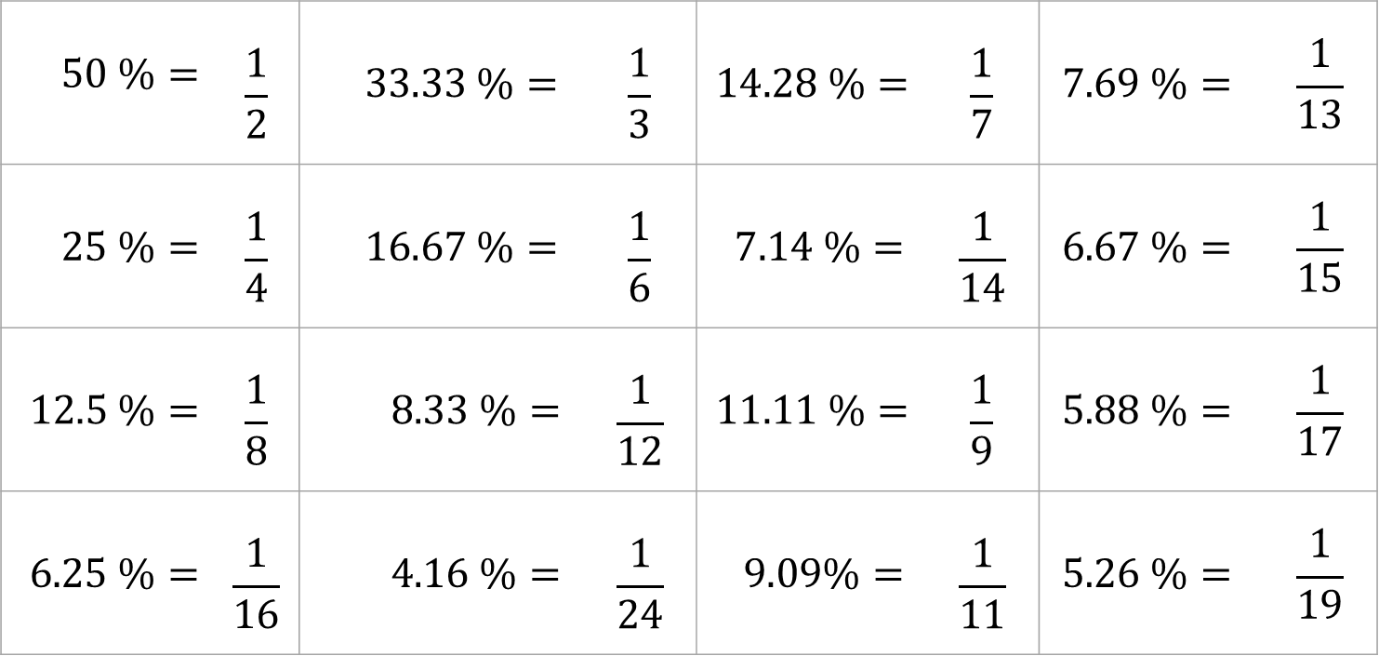
Introduction
$$50 \%=$$ | $$\frac{1}{2}$$ | $$33.33 \%=$$ | $$\frac{1}{3}$$ | $$14.28 \%=$$ | $$\frac{1}{7}$$ | $$7.69 \%=$$ | $$\frac{1}{13}$$
$$25 \%=$$ | $$\frac{1}{4}$$ | $$16.67 \%=$$ | $$\frac{1}{6}$$ | $$7.14 \%=$$ | $$\frac{1}{14}$$ | $$6.67 \%=$$ | $$\frac{1}{15}$$
$$12.5 \%=$$ | $$\frac{1}{8}$$ | $$8.33 \%=$$ | $$\frac{1}{12}$$ | $$11.11 \%=$$ | $$\frac{1}{9}$$ | $$5.88 \%=$$ | $$\frac{1}{17}$$
$$6.25 \%=$$ | $$\frac{1}{16}$$ | $$4.16 \%=$$ | $$\frac{1}{24}$$ | $$9.09\%=$$ | $$\frac{1}{11}$$ | $$5.26 \%=$$ | $$\frac{1}{19}$$

Slide 3
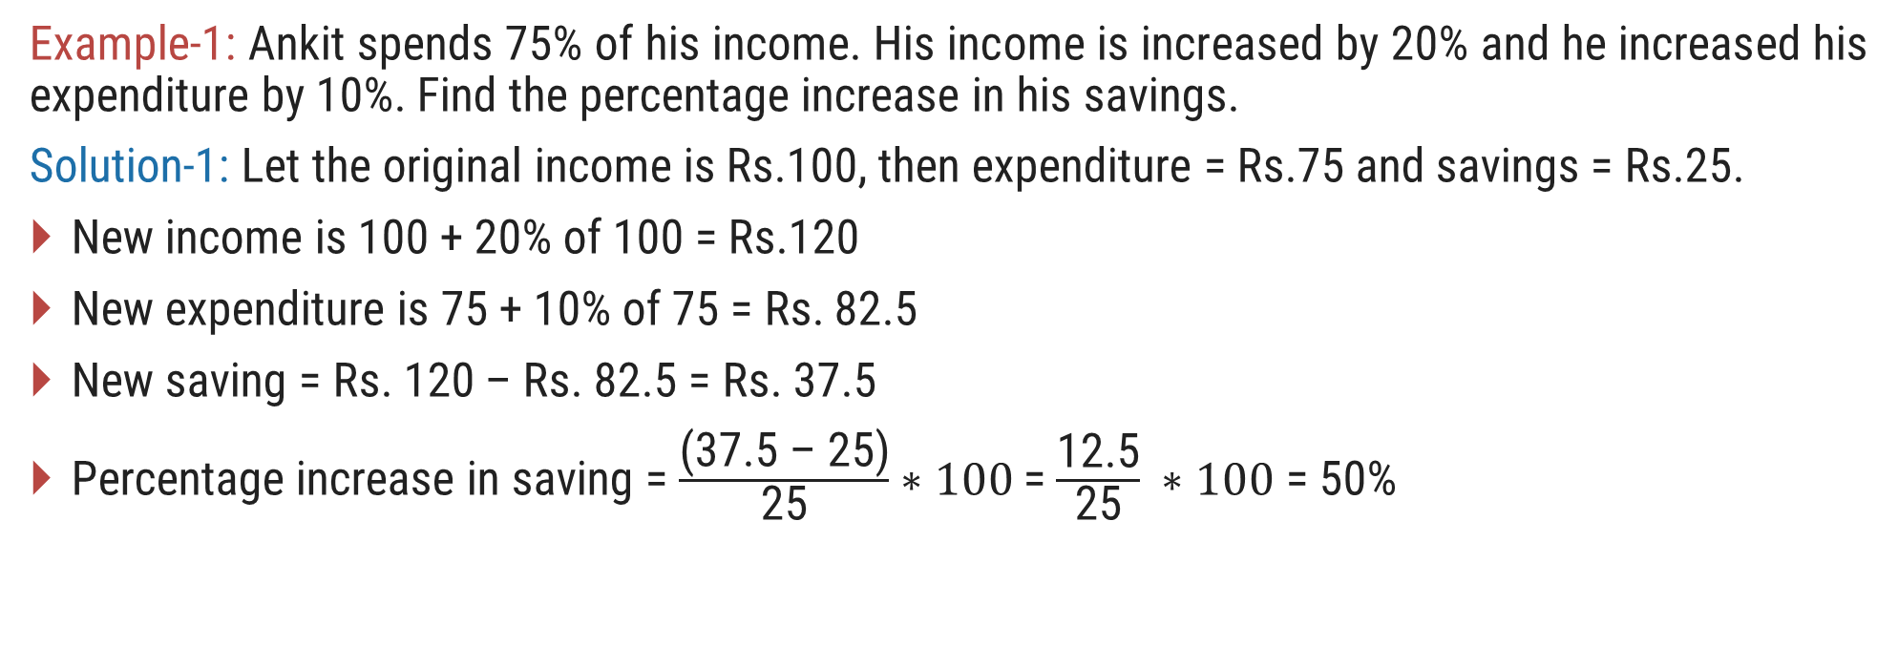
Examples
Example-1: Ankit spends 75% of his income. His income is increased by 20% and he increased his expenditure by 10%. Find the percentage increase in his savings.
Solution-1: Let the original income is Rs.100, then expenditure = Rs.75 and savings = Rs.25.
New income is 100 + 20% of 100 = Rs.120
New expenditure is 75 + 10% of 75 = Rs. 82.5
New saving = Rs. 120 – Rs. 82.5 = Rs. 37.5
Percentage increase in saving = $\frac{\text{(3}\text{7}\text{.5 – 2}\text{5}\text{)}}{\text{2}\text{5}}∗100$= $\frac{\text{12.5}}{\text{2}\text{5}} ∗100$ = 50%

Slide 4
Examples
Example-2: In an election between two candidates, 75% of the voters cast their votes, out of which 2% of the votes were declared invalid. A candidate got 9261 votes which were 75% of the total valid votes. Find the total numbers of votes enrolled in that election.
Solution-2:

Slide 5
Exercise
Ex-1: If the numerator of a fraction be increased by 15% and its denominator be diminished by 8%, the value of the fraction is 15/16. Find the original fraction.
Ex-2: 10% of the inhabitants of a village died of a cholera, a panic set in, during which 25% of the remaining inhabitants left the village. The population is then reduced to 4050. Find the number of original inhabitants.
Ex-3: If A’s salary is 20% less than B’s salary, by how much percent is B’s salary more than A?
Ex-4: In an examination, 80% of the students passed in English, 85% passed in Mathematics and 75% passed in both English and Mathematics. If 40 students failed in both the subjects, find the total number of students.
Ans = 3/4
Ans = 6000
Ans = 25%
Ans = 400

